Slide 1

The Infinite Dial 2021
Australia
#InfiniteDial
Major sponsor:

Slide 2
Presentation Outline
STUDY overview &
Methodology
Radio:
Live &
on demand
In-car
media
Online audio
Online
Audio streaming services
Observations
Smart
speakers
podcasting

Slide 3
Study Overview
Infinite Dial Australia explores the penetration of online digital audio in Australia, as well as the online platforms and technologies that Australians are using
The Infinite Dial is the longest-running survey of digital media consumer behaviour in America
The Infinite Dial Australia report mirrors the Infinite Dial U.S. reports, which have been undertaken annually since 1998 by Edison Research, and cover a wide range of online digital media topics
This is the fifth annual Infinite Dial Australia report
This study is designed to allow for direct comparisons between the Australian and U.S. markets

Slide 4
Study Methodology
In the first quarter of 2021, Edison Research conducted a national telephone survey of 1,001 Australians age 10+
For comparison to U.S. Infinite Dial, this presentation shows data among those age 12+
Data weighted to national 12+ population figures

Slide 5
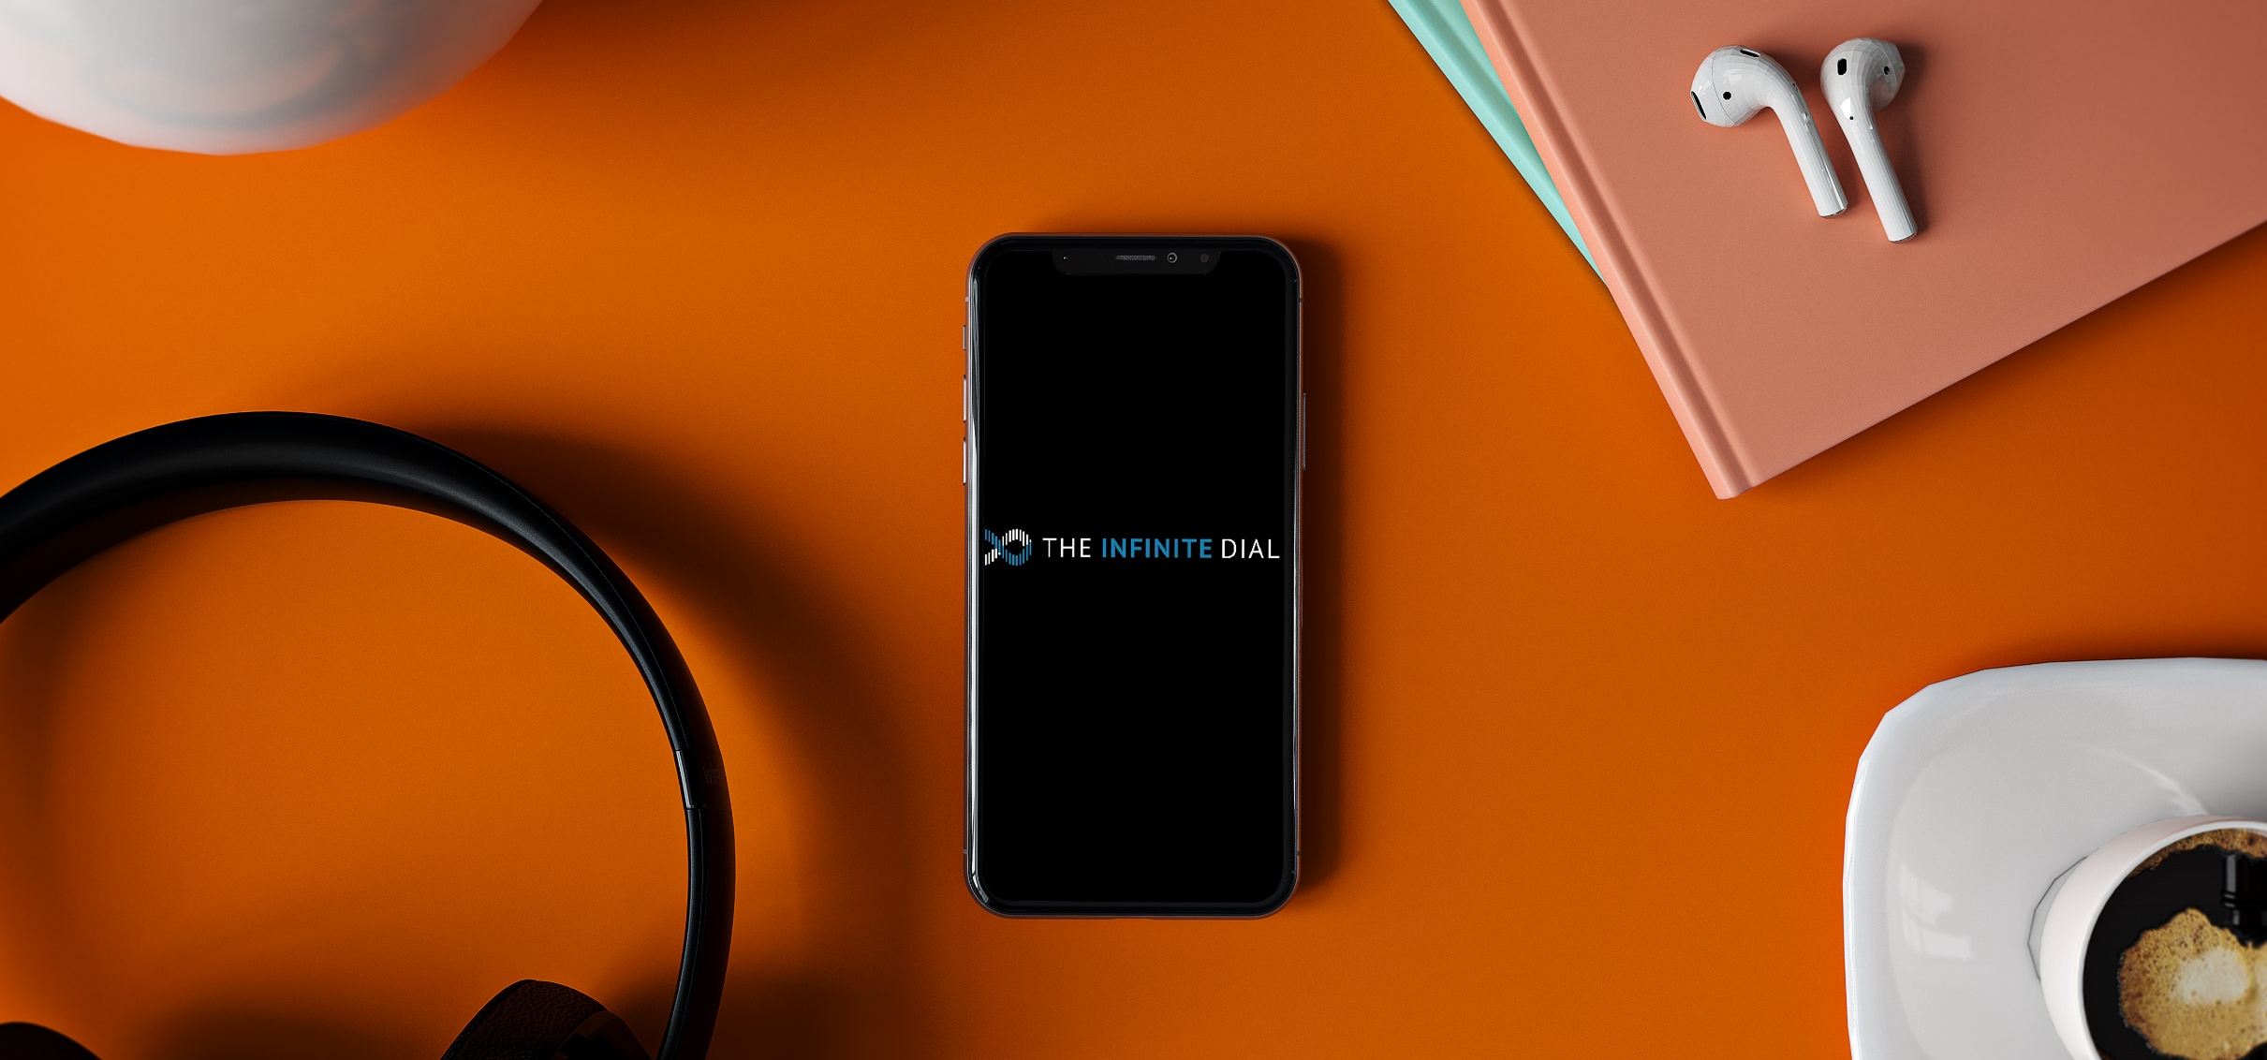
Online Audio

Slide 6
Monthly Online Audio Listening
Total Australian Population 12+
% listened to online audio in last month
Online Audio = Listening to AM/FM/dab+ radio stations online and/or listening to audio content available only on the Internet including podcasts and streaming services

Slide 7
Weekly Online Audio Listening
Total Australian Population 12+
% listened to online audio in last Week
Online Audio = Listening to AM/FM/dab+ radio stations online and/or listening to audio content available only on the Internet including podcasts and streaming services

Slide 8
Average Time Spent Listening to Online Audio
Base: Australian 12+ Weekly Online Audio Listeners
Hours: Minutes in last week
Online Audio = Listening to AM/FM/dab+ radio stations online and/or listening to audio content available only on the Internet including podcasts and streaming services

Slide 9

Radio: Live & On Demand

Slide 10
Listening to Radio Content in Last Month – Live & On Demand
Total Australian Population 12+
% Listened to over-the-air or online AM/FM/DAB+ Radio for at least 15 minutes in last month or catch-up podcasts at least once a Month

Slide 11
Listening to Radio Content in Last Week – Live & On Demand
Total Australian Population 12+
% Listened to over-the-air or online AM/FM/DAB+ Radio for at least 15 minutes in last week or catch-up podcasts at least once a week

Slide 12
Sources Used to Listen to Online AM/FM/DAB+ Radio
Australian AGE 12+ AND Listened to AM, FM, or DAB+ radio stations though the Internet
% using source to listen to AM/FM/DAB+ radio

Slide 13
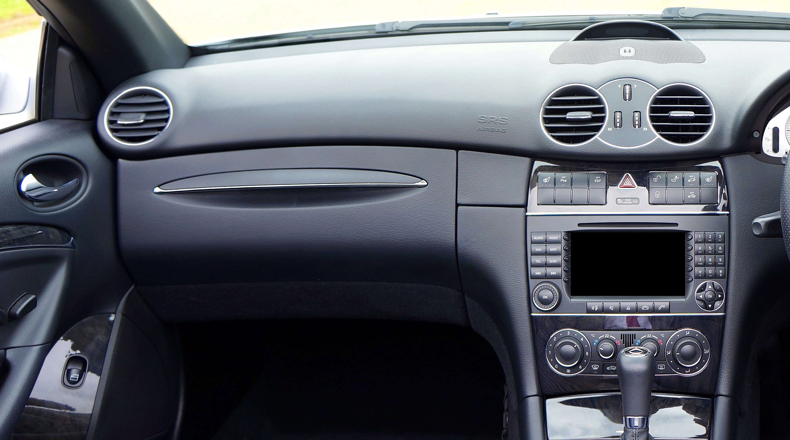
In-Car Media

Slide 14
Audio Sources Used in Car
Base: Australian age 18+ and Has Driven/Ridden in Car in last month; 88%
% using audio source in car
*Such as Spotify, youtube, or apple music

Slide 15
Audio Sources Used in Car
Base: Age 18+ and Has Driven/Ridden in Car in last month
% using audio source in car
*Such as Spotify, youtube, or apple music

Slide 16
In-Dash Systems that can Receive Info/Entertainment over the Internet
Base: Australian age 18+ and Has Driven/Ridden in Car in last month; 88%
% owning in-dash system that receives information/entertainment over the internet

Slide 17
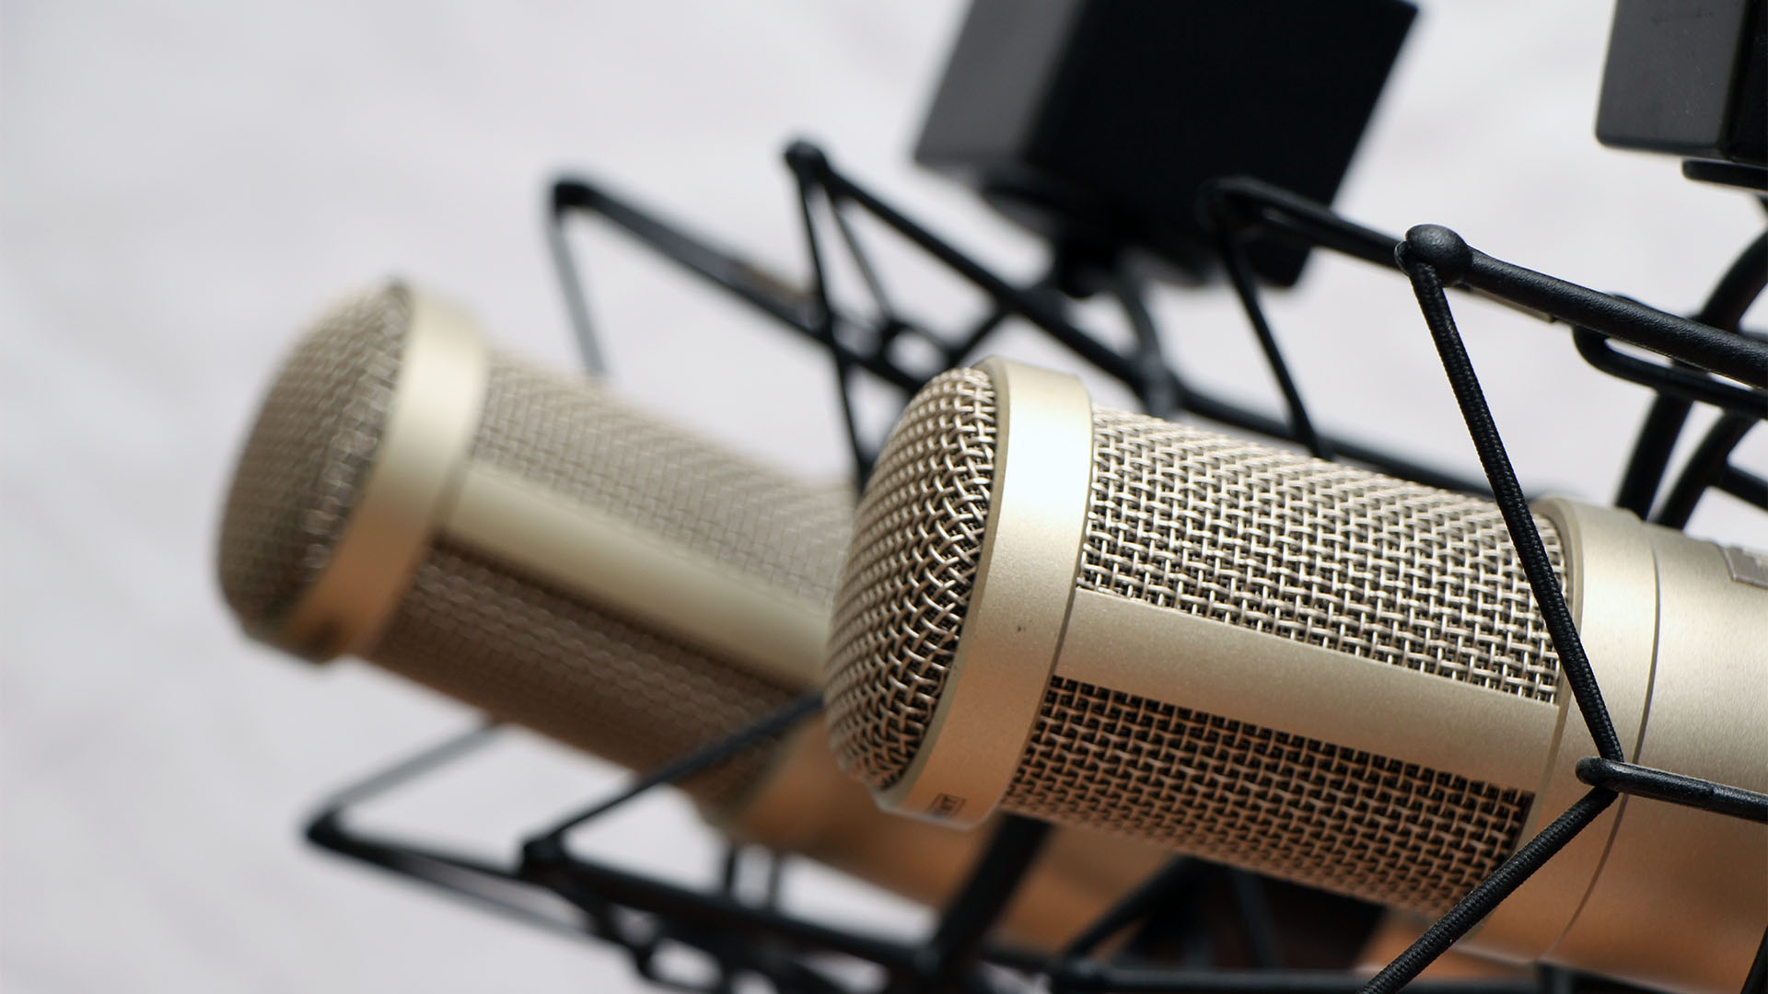
Podcasting

Slide 18
Podcasting Awareness
Total Australian Population 12+
% Aware of podcasting

Slide 19
Podcasting Awareness
Populations 12+
% Aware of podcasting

Slide 20
Monthly Podcast Listening
Total Australian Population 12+
% Listened to a podcast in last month

Slide 21
Monthly Podcast Listening
Populations 12+
% Listened to a podcast in last month

Slide 22
Weekly Podcast Listening
Total Australian Population 12+
% Listened to a podcast in last Week

Slide 23
Weekly Podcast Listening
Populations 12+
% Listened to a podcast in last Week

Slide 24
Podcast Listening Locations
Base: Australian 12+ and Listened to podcast in last month; 37%
% Listened to a podcast in location

Slide 25
Device Used Most Often to Listen to Podcasts
Base: Australian 12+ and listened to podcast in last month; 37%
Smartphone/Tablet/portable device
Computer
other
In-Car Entertainment system

Slide 26
Number of Podcasts Listened to in Last Week
Base: Australian 12+ and Listened to podcast in last week; 26%
Australian weekly podcast listeners averaged
five podcasts
in the last week

Slide 27
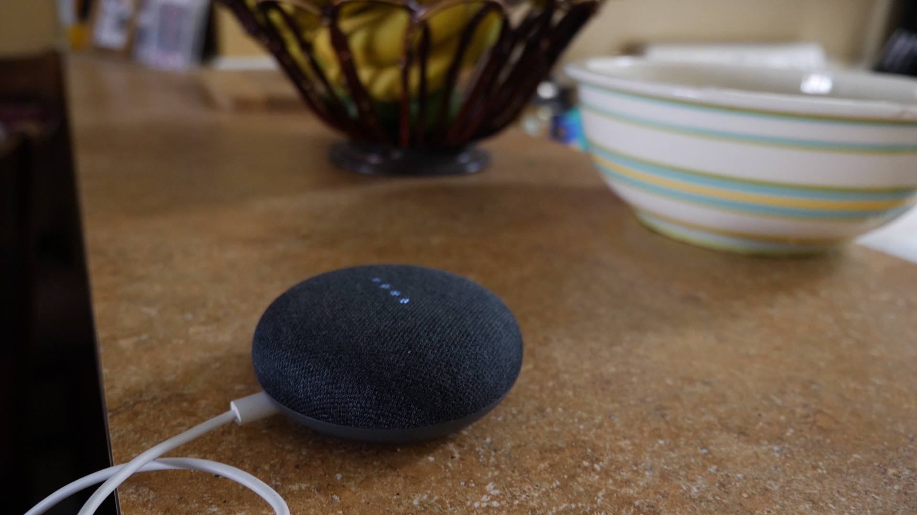
Smart Speakers

Slide 28
Smart Speaker Ownership
Total Australian Population 12+
% owning a Smart Speaker

Slide 29
Smart Speaker Ownership
Populations 12+
% owning a Smart Speaker

Slide 30
Smart Speaker Ownership
Total Australian Population 12+
% owning Smart Speaker Brand
< 1%

Slide 31
Number of Smart Speakers in Household
Base: Australian 12+ who own a Smart Speaker
Three
or more
Mean
# of smart speakers
One
Two
1.4
1.7
1.9

Slide 32
Number of Smart Speakers in Household
Base: Age 12+ who own a smart speaker
Three
or more
Mean
# of smart speakers
One
Two
1.9
2.2

Slide 33
Online Audio Streaming Services

Slide 34
Awareness of Online Audio Streaming Services
Total Australian Population 12+
% aware of Online Audio Streaming Service

Slide 35
Awareness of Online Audio Streaming Services
Populations 12+
% aware of Online Audio Streaming Service

Slide 36
Free vs. Paid Subscriptions to Online Audio Streaming Services
Base: Australian 12+ and Listened to online audio streaming service in last month
Use only the free service
Pay for a subscription

Slide 37
Weekly Listening to Online Audio Streaming Services
Total Australian Population 12+
% Listened to Online Audio Streaming Service in Last week
Notes:
iHeartRadio has a higher usage than Amazon, the lowest on this graph.. Can we swap iHeart in and take Amazon out?

Slide 38
Weekly Usage of YouTube for Music or Music Video
Total Australian Population 12+
% Used YouTube for Music or Music Videos in last week

Slide 39
Observations
Despite the disruptions of 2020, or more likely on account of the disruptions, digital audio options grew at a significant pace

Slide 40

Observations
Podcasts make a big leap forward in Australia, now just mere months behind the figures we see in the USA and Canada

Slide 41
Observations
Smart Speakers also have a big year, likely propelled at least in part by people staying in their homes more
Coming soon – the Smart Audio Report Australia

Slide 42
Observations
Despite the advancements in digital usage and the disruptions of the last year, broadcast radio and its content continues to serve enormous numbers of Australians each week and month

Slide 43
The Infinite Dial 2021
®
Australia
#InfiniteDial

