Slide 1

The Infinite Dial 2020
Australia
#InfiniteDial

Slide 2
Presentation Outline
STUDY overview & methodology
Radio &
Radio simulcast
In-Car
Media
Podcasting
online audio streaming services
Smart
speakers
Observations
Online audio

Slide 3
Study Overview
Infinite Dial Australia explores the penetration of online digital audio in Australia, as well as the online platforms and technologies that Australians are using
The Infinite Dial is the longest-running survey of digital media consumer behaviour in America
The Infinite Dial Australia report mirrors the Infinite Dial U.S. reports, which have been undertaken annually since 1998 by Edison Research, and cover a wide range of online digital media topics
This is the fourth annual Infinite Dial Australia report
This study is designed to allow for direct comparisons between the Australian and U.S. markets

Slide 4
Study Methodology
In the first quarter of 2020, prior to the COVID-19 pandemic, Edison Research conducted a national telephone survey of 1,014 Australians age 12 and older
Data weighted to national 12+ population figures

Slide 5

Radio & Radio Simulcast

Slide 6
Listening to Radio Content: Live Radio or Catch-up Podcasts in the Last Month
Total Australian Population 12+
% Listened to over-the-air or online AM/FM/DAB+ Radio for at least 15 minutes in last month or catch-up podcasts at least once a month

Slide 7
Listening to Radio Content: Live Radio or Catch-up Podcasts in the Last Week
Total Australian Population 12+
% Listened to over-the-air or online AM/FM/DAB+ Radio for at least 15 minutes in last week or catch-up podcasts at least once a week

Slide 8
Listening to AM/FM/DAB+ Radio in the Last Week
Total Australian Population 12+

Slide 9
Listening to AM/FM Radio in the Last Week
GermanY, south Africa MAJOR METRO COMMERCIAL, u.S., AUSTRALIA, AND Canada Populations age 18+
% Listening to AM/FM Radio in last week
AM/FM Radio INCLUDES BOTH OVER-THE-AIR AND ONLINE

Slide 10
Source Used Most Often to Listen to Online AM/FM/DAB+ Radio
Base: Australian Population 12+ who listened to Online am/fm/dab+ radio in last month
Aggregator
(SUCH AS RadioApp or Tunein)
Radio Station’s website
Radio Station’s app
on mobile device
Don’t Know

Slide 11
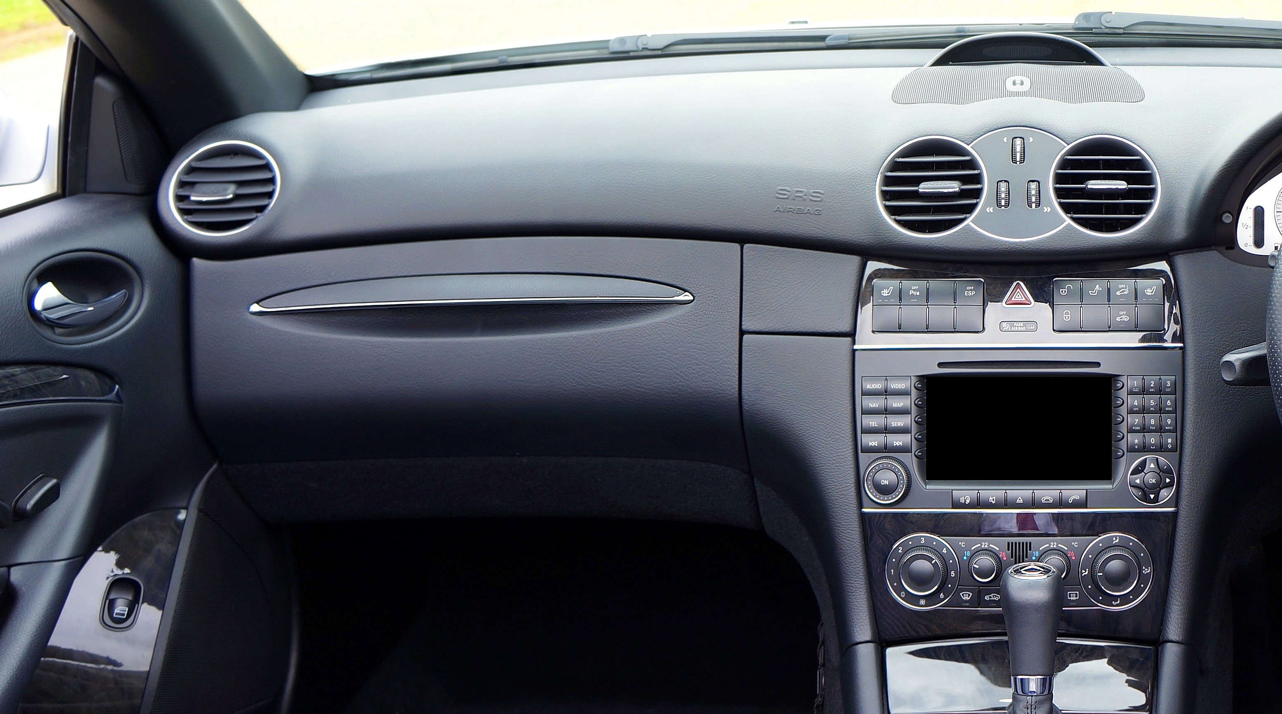
In-Car Media

Slide 12
Audio Sources Used in Car
Base: Australian 18+ and Have Driven/Ridden in Car in last month; 87%
% using audio source in car
*Such as Spotify, youtube, or apple music

Slide 13
Audio Sources Used in Car
Base: Age 18+ and Have Driven/Ridden in Car in last month
% using audio source in car
*Such as Spotify, youtube, or apple music

Slide 14
Audio Source Used Most Often in Car
Base: Australian 18+, have Driven/Ridden in Car in last month, and use any audio source in car
Owned
music
AM/FM
streams
aM/FM/DAB radio
Internet-Only
audio
other
Notes:
Owned music includes CDs and digital files

Slide 15
Online Audio Listening in Car Through a Cell Phone
Total Australian Population 12+
% EVER Listened to online audio In a car through a cell phone

Slide 16
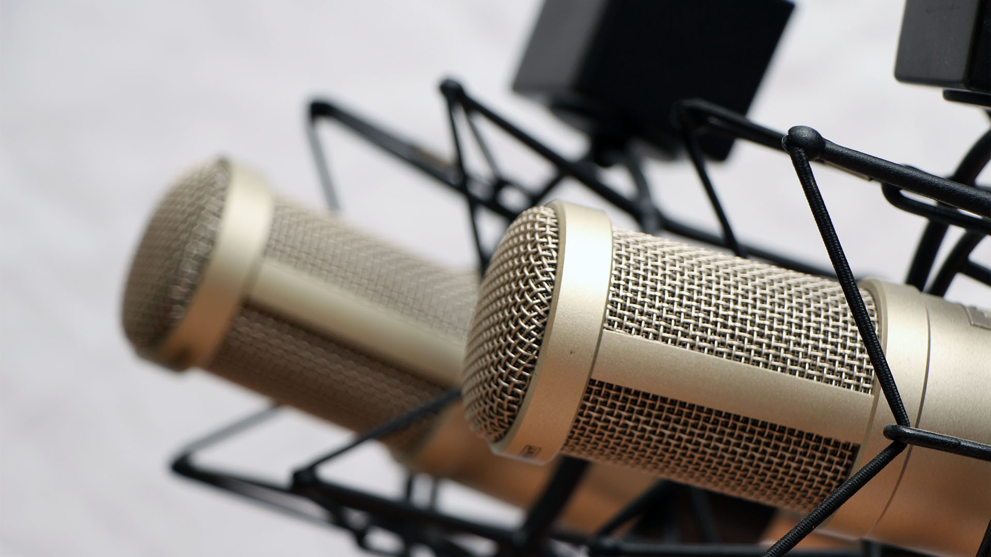
Podcasting

Slide 17
Podcasting Awareness
Total Australian Population 12+
% Aware of the term “podcasting”

Slide 18
Podcasting Awareness
Populations 12+
% Aware of the term “podcasting”

Slide 19
Monthly Podcast Listening
Total Australian Population 12+
% Listened to a podcast in last month

Slide 20
Monthly Podcast Listening
Populations 12+
% Listened to a podcast in last month

Slide 21
Weekly Podcast Listening
Total Australian Population 12+
% Listened to a podcast in last Week

Slide 22
Weekly Podcast Listening
Populations 12+
% Listened to a podcast in last Week

Slide 23
Podcast Listening Locations
Base: Australian 12+ and Ever Listened to a podcast; 32%
% Listened to a podcast in location

Slide 24
Device Used Most Often to Listen to Podcasts
Base: Australian 12+ and Ever Listened to a podcast; 32%
Smartphone/Tablet/portable device
Computer
other
In-Car Entertainment system

Slide 25
Frequency of Listening to Podcasts
Base: Australian 12+ and Ever Listened to a podcast; 32%
“How often would you say you listen to podcasts?”

Slide 26
Amount of Podcast Episode Listened to
Base: Australian 12+ and Ever Listened to a podcast; 32%
“Think about the audio podcast episodes you listen to. Do you typically listen to…?”

Slide 27
Podcasts Downloaded and Listened to Later
Base: Australian 12+ and EVER DOWNLOAD PODCASTS TO LISTEN LATER; 16%
“When did you listen to the last podcast you downloaded and listened to at a later time?”

Slide 28
Number of Podcasts Listened to in Last Week
Base: Australian 12+ and Listened to podcast in last week; 17%
Australian weekly podcast listeners averaged
Six podcasts
in the last week

Slide 29

Online Audio

Slide 30
Average Time Spent Listening to Online Audio
Base: Australian 12+ Weekly Online Audio Listeners
Hours:Minutes in last week
Online Audio = Listening to AM/FM/dab+ radio stations online and/or listening to streamed audio content available only on the Internet

Slide 31
Devices Used to Listen to Online Audio
Base: Australian 12+ who ever listened to online audio
% currently ever listen to online audio through device
Online Audio = Listening to AM/FM/dab+ radio stations online and/or listening to streamed audio content available only on the Internet

Slide 32
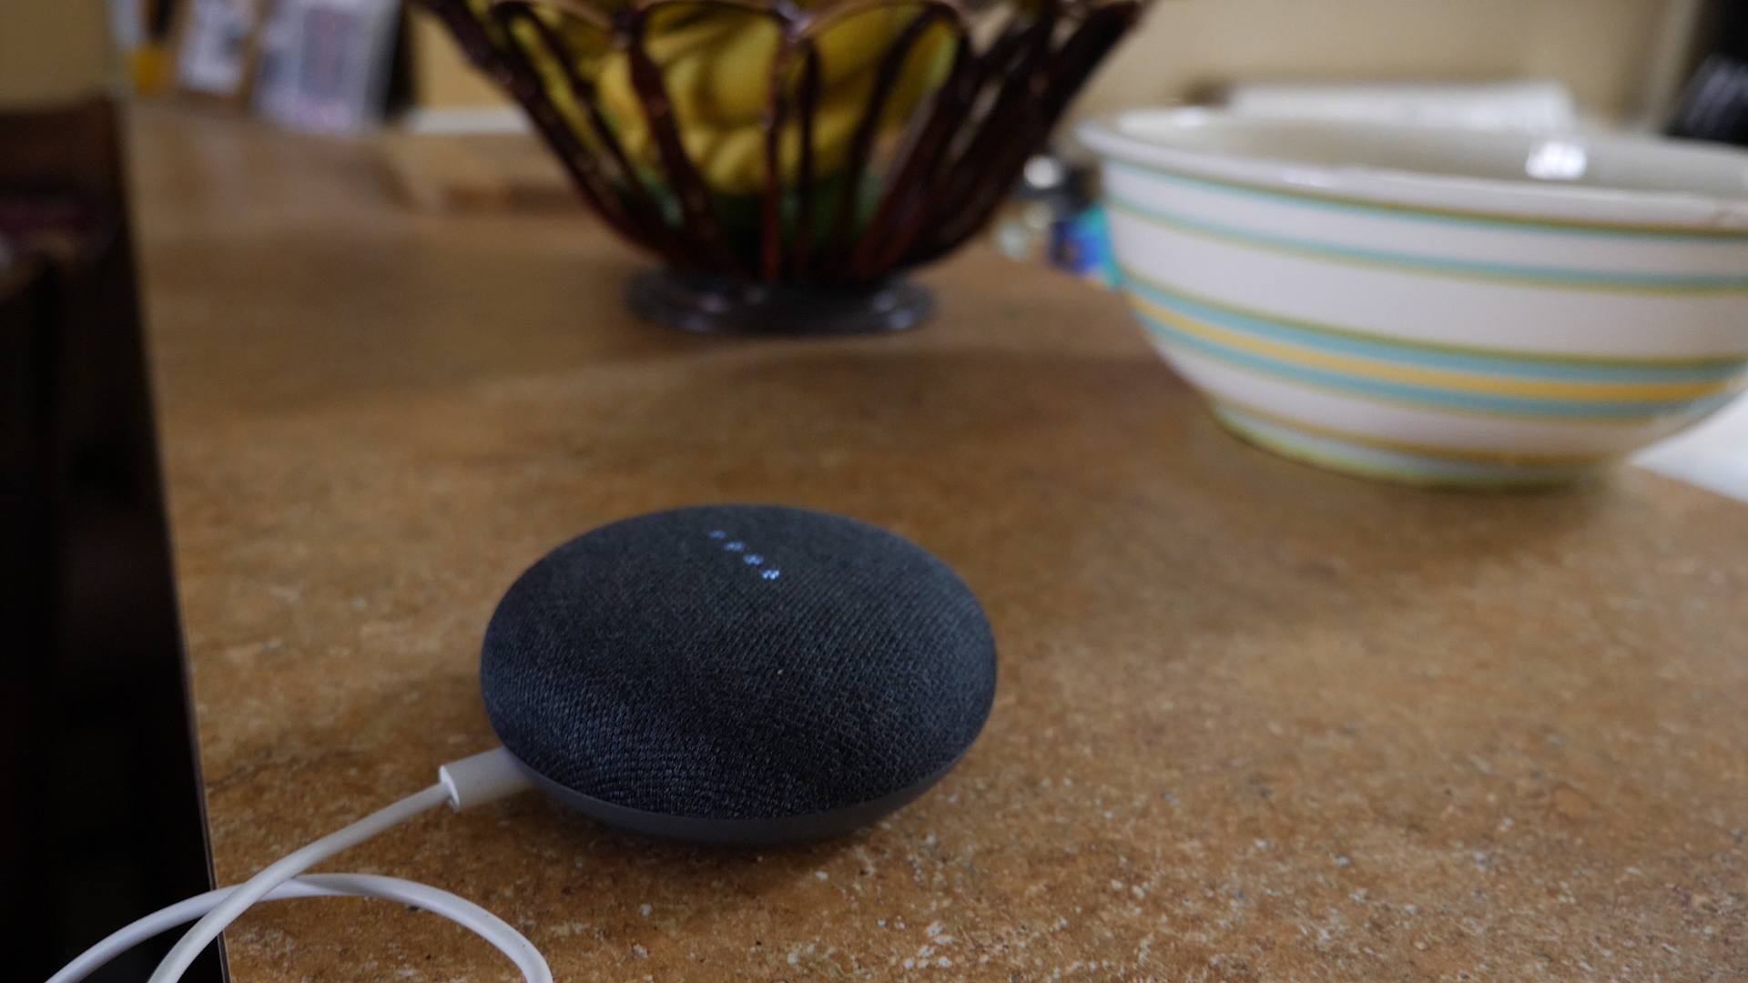
Smart Speakers

Slide 33
Smart Speaker Awareness
Germany, south Africa MAJOR METRO COMMERCIAL, u.S., AUSTRALIA, and Canada Populations age 18+
% Aware of Any Smart Speaker Brand

Slide 34
Smart Speaker Ownership
Total Australian Population 12+
% owning a Smart Speaker Brand

Slide 35
Smart Speaker Ownership
Populations 12+
% owning a Smart Speaker

Slide 36
Smart Speaker Ownership
Germany, south Africa MAJOR METRO COMMERCIAL, u.S., AUSTRALIA, and Canada Populations age 18+
% own Any Smart Speaker Brand

Slide 37
Smart Speaker Ownership
Total Australian Population 12+
% owning Smart Speaker Brand
< 1%

Slide 38
Number of Smart Speakers in Household
Base: Australian Age 12+ Smart Speaker Owners
Three
or more
Mean
# of smart speakers
One
Two
1.4
1.7

Slide 39
Number of Smart Speakers in Household
Base: Age 12+ Smart Speaker Owners
Three
or more
Mean
# of smart speakers
One
Two
1.7
2.2

Slide 40
Usage of Smart Speaker Compared to First Month
Base: Australian 12+ Smart Speaker Owners
“Compared to the first month you had your smart speaker, would you say you are now using your smart speaker more, less, or the same amount?”

Slide 41

Online Audio Streaming Services

Slide 42
Awareness of Online Audio Streaming Services
Total Australian Population 12+
% aware of Online Audio Streaming Service
*2017-2018: Google Play All Access

Slide 43
Awareness of Online Audio Streaming Services
Populations 12+
% aware of Online Audio Streaming Service

Slide 44
Listened to Online Audio Streaming Services in Last Month
Total Australian Population 12+
% Listened to Online Audio Streaming Service in last month
<1%
*2017-2018: Google Play All Access

Slide 45
Free vs. Paid Subscriptions to Online Audio Streaming Services
Base: Australian 12+ and Listened to online audio streaming service in last month
Use only the free service
Pay for a subscription

Slide 46
Free vs. Paid Subscriptions to Spotify
Base: Australian 12+ and Listened to Spotify in last month
Use only the free service
Pay for a subscription

Slide 47
Weekly Listening to Online Audio Streaming Services
Total Australian Population 12+
% Listened to Online Audio Streaming Service in Last week
*2017-2018: Google Play All Access
Notes:
iHeartRadio has a higher usage than Amazon, the lowest on this graph.. Can we swap iHeart in and take Amazon out?

Slide 48
Weekly YouTube Music Usage
Total Australian Population 12+
% Used YouTube for Music or Music Videos in last week

Slide 49
Weekly YouTube Music Usage
Populations 12+
% Used YouTube for Music or Music Videos in last week

Slide 50
Observations
The audio space is extremely dynamic today, creating opportunities and threats for all players

Slide 51
Observations
The audio space is extremely dynamic today, creating opportunities and threats for all players
AM/FM/DAB+ Radio remains very strong and performs much more strongly than in America

Slide 52

Observations
Podcasting continues to grow but lags in comparison to trends from the USA

Slide 53
Observations
Podcasting continues to grow but lags in comparison to trends from the USA
Smart speakers represent an exciting new pathway for audio consumption

Slide 54
The Infinite Dial 2020
®
Australia
#InfiniteDial

