Slide 1




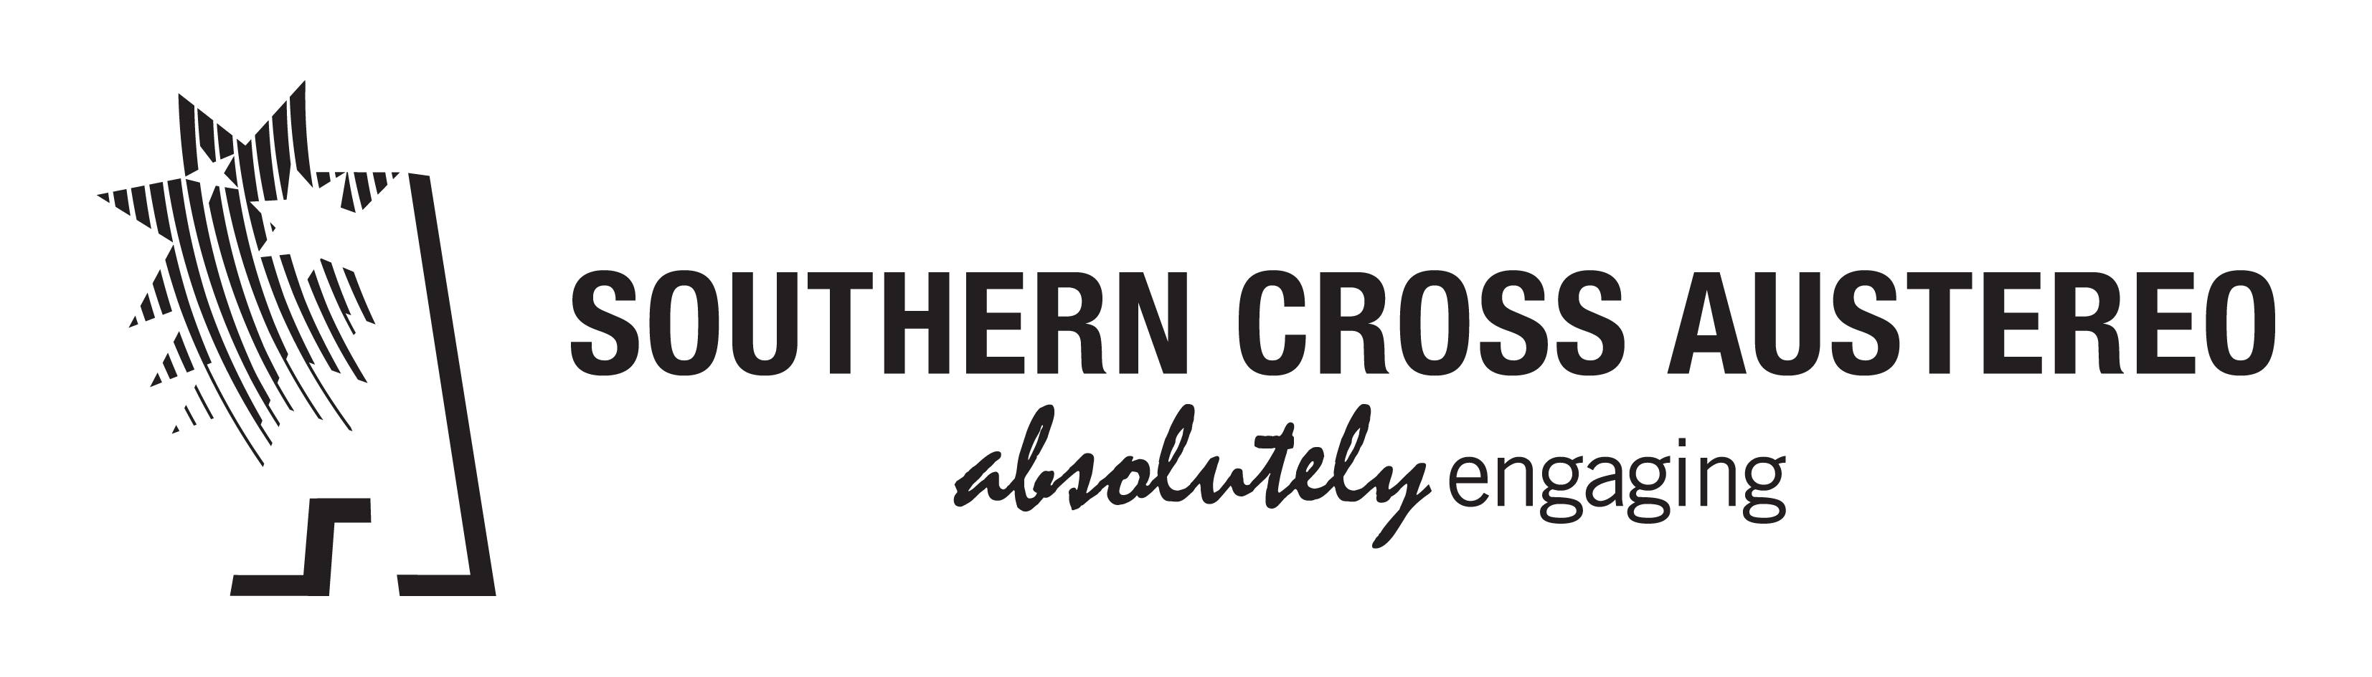

AUSTRALIA 2017
#INFINITEDIALAUSTRALIA

Slide 2
Commercial Radio Australia Initiatives
Contemporary rebrand of our industry marketing campaign - August 2017
Automated Holdings – first all of media automated rollout - September 2017
Ongoing review of radio audience measurement
Regional surveys – nearly 50 surveys across Australia
Ongoing promotion of RadioApp – new stations, new features
National Radio Conference & ACRAs - 13 & 14 October 2017

Slide 3
Study Overview
The Infinite Dial is the longest-running survey of digital media consumer behavior in America
This inaugural Infinite Dial Australia report mirrors the Infinite Dial U.S. reports which have been undertaken annually since 1998 by Edison Research and cover a wide range of online digital media topics
Infinite Dial Australia explores the penetration of online digital audio and social media in Australia and the online platforms and technologies that Australians are using
This study is designed to allow for direct comparisons between the Australian and U.S. markets

Slide 4
Study Methodology
In the first quarter of 2017, Edison Research conducted a national telephone survey of 1,007 people aged 12 and older
Data weighted to national 12+ population figures

Slide 5

RADIO & RADIO SIMULCAST

Slide 6
Listening to AM/FM Radio in
Australia in the Last Week
% listened to AM/FM Radio in last week
*AM/FM Radio includes both “over-the-air” and online

Slide 7
Listening to AM/FM Radio in the Last Week
Base: Total Population 12+
% listened to AM/FM Radio in last week
*AM/FM Radio includes both “over-the-air” and online

Slide 8
Number of Radios Owned in Homes in Australia
Four or
more
Mean # of Radios
Zero
One to Three
1.7
1.3
1.6
2.2

Slide 9
Number of Radios Owned in Home
Four or
more
Mean # of Radios
Zero
One to Three
1.7
1.9
*Not asked in U.S. in 2017

Slide 10
Online Listening to AM/FM Radio in Australia in the Last Month
% listened to AM/FM radio stations online in last month

Slide 11
Online Listening to AM/FM Radio in the Last Month
Base: Total Population 12+
% listened to AM/FM radio stations online in last month

Slide 12
Online Listening to AM/FM Radio in Australia in the Last Week
% listened to AM/FM radio stations online in last week

Slide 13

AUDIO AGGREGATORS

Slide 14
Audio Aggregator Brand
Awareness in Australia
Base: Total Population 12+
% aware of audio aggregator brand

Slide 15
Audio Aggregator Brand Awareness
Base: Total Population 12+
% aware of audio aggregator brand

Slide 16
Audio Aggregators:
Monthly Listening in Australia
Base: Total Population 12+
% listened to aggregator in last month

Slide 17
Audio Aggregators:
Weekly Listening in Australia
Base: Total Population 12+
% listened to aggregator in last week

Slide 18
ONLINE AUDIO STREAMING SERVICES

Slide 19
Awareness of Online Audio
Streaming Services in Australia
Base: Total Population 12+
% aware of online audio streaming service
*Asked as “Apple Music, the paid music subscription from Apple”

Slide 20
Awareness of Online Audio
Streaming Services
Base: Total Population 12+
% aware of online audio streaming service
*Asked as “Apple Music, the paid music subscription from Apple”

Slide 21
Listening to Online Audio Streaming Services in Australia in the Last Week
Base: Total Population 12+
% listened to online audio streaming service in last week
*Asked as “Apple Music, the paid music subscription from Apple”

Slide 22

IN-CAR AUDIO

Slide 23
Audio Sources Used in Car in Australia
Base: Age 18+ and has driven/ridden in car in last month; 88%
% currently ever using audio source in car

Slide 24
Audio Sources Used in Car
Base: Age 18+ and has driven/ridden in car in last month; 88%
% currently ever using audio source in car

Slide 25
Audio Sources Used at Least
‘Most of the Times’ in Car
“In your primary car, how often do you use…?”
Base: Age 18+ and has driven/ridden in car in last month; 88%
% using audio source “most of” or “almost all of” times in car

Slide 26

PODCASTING

Slide 27
Familiar with the term
“Podcasting” in Australia
% familiar with the term podcasting

Slide 28
Familiar with the term “Podcasting”
Base: Total Population 12+
% familiar with the term podcasting

Slide 29
Monthly Podcast Listening in Australia
% listened to a podcast in the last month

Slide 30
Monthly Podcast Listening
Base: Total Population 12+
% listened to a podcast in the last month

Slide 31
Monthly Podcast Listening
Base: Total Population 12+
% listened to a podcast in the last month

Slide 32
Weekly Podcast Listening in Australia
% listened to a podcast in the last week

Slide 33
Weekly Podcast Listening
Base: Total Population 12+
% listened to a podcast in the last week

Slide 34
Number of Podcasts
Listened to in Last Week in Australia
Base: Weekly Podcast Listeners
Average of six podcasts listened in last week

Slide 35
Device Used Most Often to Listen to Podcasts
Base: Ever Listened to a Podcast
Computer
Smartphone/tablet/portable device
Don’t Know

Slide 36
Podcast Listening Locations in Australia
Base: Weekly Podcast Listeners
% ever listened to podcasts in location

Slide 37
Amount of Podcast Episode
Listened to in Australia
Base: Ever Listened to a Podcast

Slide 38
Amount of Podcast Episode Listened To
Base: Ever Listened to a Podcast
The entire
podcast episode
Most of the
podcast episode
Less than
half of episode
Just the
beginning

Slide 39
Method of Listening to
Podcasts in Australia
Base: Ever listened to a podcast
% ever using method to listen to podcasts
Click on podcast
and listen immediately
Download podcast
manually and listen later
Subscribe to podcast and download automatically to listen later

Slide 40
Percent of all podcasts downloaded and then listened to
Base: Have ever downloaded podcasts to listen at a later time
100%-76%
75%-51%
50%-26%
25%-1%

Slide 41
Number of Podcasts
Subscribed to in Australia
Base: Have ever subscribed to podcasts
Average of five podcasts subscribed to

Slide 42
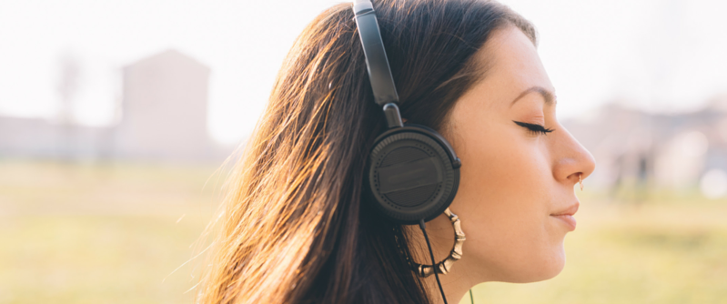
MUSIC DISCOVERY

Slide 43
Sources Used for Keeping
Up-to-Date with Music in Australia
Base: Those saying it is “Very Important” or “Somewhat Important” to keep up-to-date with music; 56%
% ever using source

Slide 44
YouTube Usage in Australia
“Have you used YouTube to watch music videos or listen to music…?”

Slide 45
YouTube Usage
“Have you used YouTube to watch music videos or listen to music…?”
Base: Total Population 12+

Slide 46

SOCIAL MEDIA

Slide 47
Social Media Usage in Australia
% currently use any social media

Slide 48
Social Media Brand Awareness in Australia
Base: Total Population 12+
% aware of social media brand

Slide 49
Social Media Brand Usage in Australia
Base: Total Population 12+
% currently ever use social media brand

Slide 50
Social Media Brand Usage in Australia
(Age 12-24)
% currently ever use social media brand

Slide 51
Social Media Brand Used
Most Often in Australia
Base: Currently use any social networking brands

Slide 52
DEVICES & TECHNOLOGIES

Slide 53
Device Ownership in Australia
Base: Total Population 12+
% owning device

Slide 54
Smartphone Ownership in Australia
% owning a smartphone

Slide 55
Smartphone Ownership
Base: Total Population 12+
% owning a smartphone

Slide 56
Tablet Ownership in Australia
% owning a tablet

Slide 57
On-Demand Video Service
Subscription in Australia
Base: Total Population 12+
% having a subscription
Subscription to
any of the above

Slide 58
On-Demand Video Service Subscription
Base: Total Population 12+
% having a subscription
Subscription to
any of the above

Slide 59
Netflix Subscription
Base: Total Population 12+
% having a subscription

Slide 60
Amazon Prime Subscription
Base: Total Population 12+
% having a subscription

Slide 61
Used On-Demand Video
Service in Last Week in Australia
Base: Total Population 12+
% using service in last week
Used any of the
above in the last week

Slide 62
Used On-Demand Video
Service in Last Week
Base: Total Population 12+
% using service in last week
Used any of the
above in the last week

Slide 63
Key Takeaways
While broadcast radio is resilient and strong in the U.S. – the medium performs yet more strongly in Australia
Australians use fewer audio options in their cars so radio is stronger there as well
Online “pureplays” are not the same factor in Australia

Slide 64
Key Takeaways
The concept of ‘Podcasting’ is better known in Australia than in the U.S. but usage is lower
New forms of digital media are major factors in Australia, driven in large measure by the Smartphone – which has even higher adoption in Australia than in the U.S.:
        Social Media (especially Facebook)
        YouTube
        Netflix

Slide 65
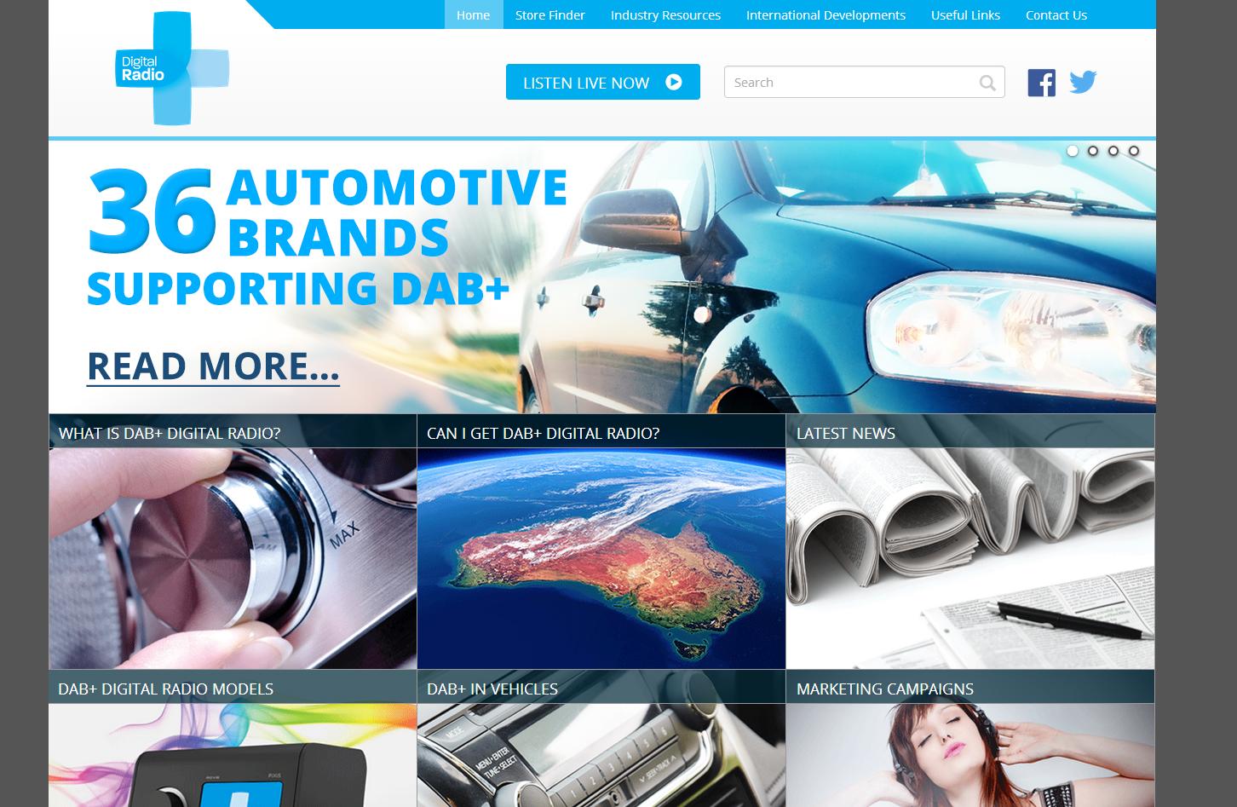
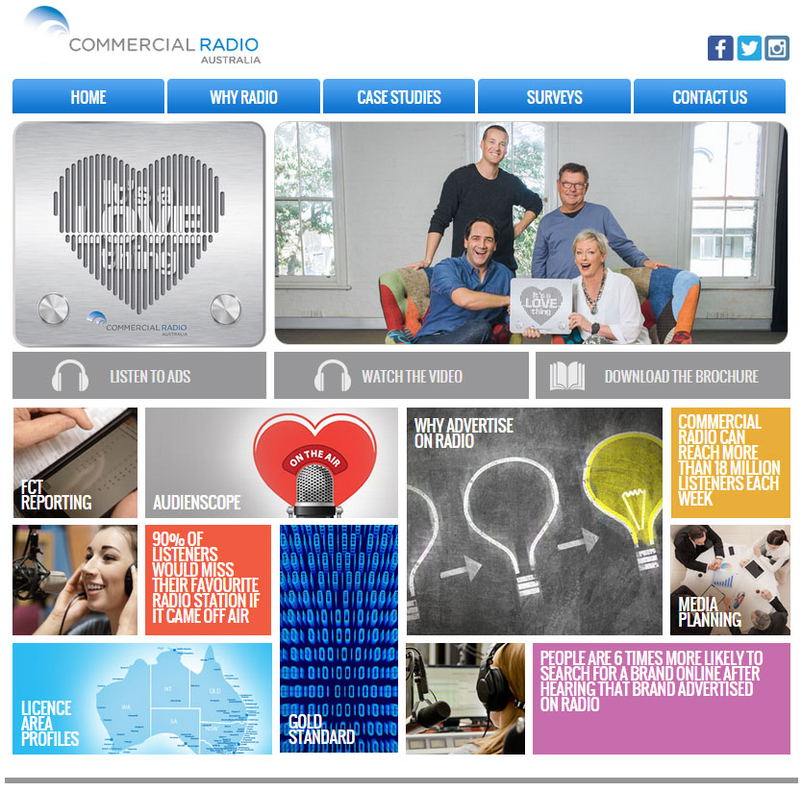
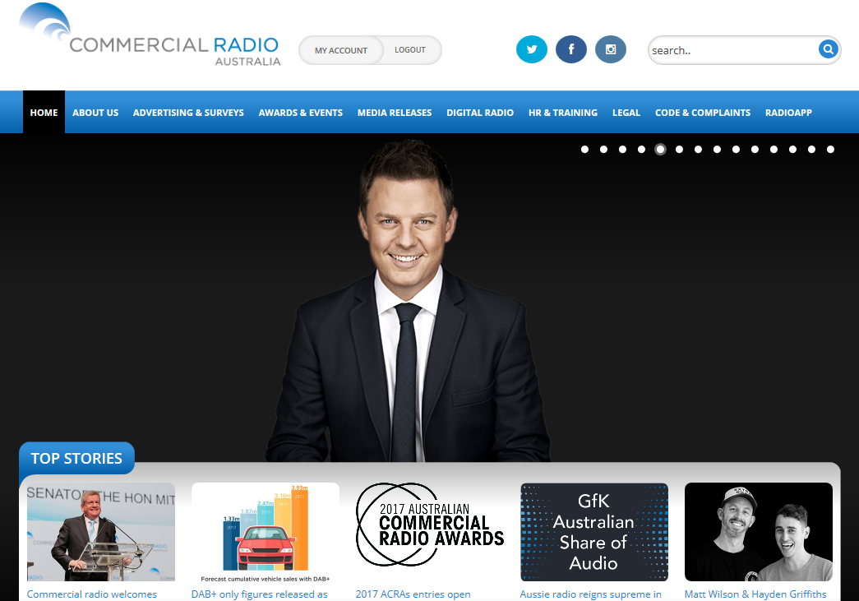
Further Information
Industry Resources
commercialradio.com.au digitalradioplus.com.au radioitsalovething.com
Contact Shannan Parker, CRA Marketing Manager – 02 9281 6577
shannan.parker@commercialradio.com.au

Slide 66
Questions?
#INFINITEDIALAUSTRALIA

