Slide 1
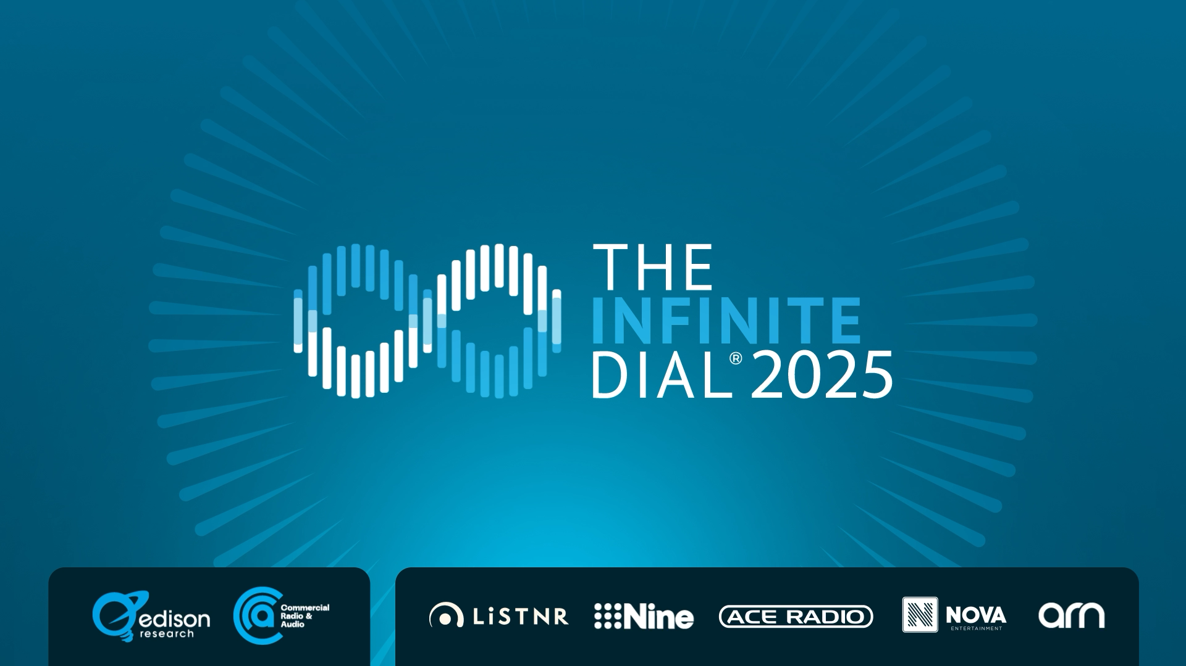

Slide 2
Executive Summary
Regional Australia's Audio Affection Grows Stronger with Radio Leading the Charge.
🎧 Commercial Radio reaches 59% or 5 million Australians in Regional Markets weekly, up 4%.
🎧 Only 28% of Regional Australians listen to ad-supported music streaming each week.
🎧 Radio remains the dominant in-car audio choice for Regional Australians, with 83% listening each month.
🎧 40% of Regional Australians listen to a podcast Monthly and 30% each week.
🎧 One in four (21%) listen to Live Streaming Radio each week in Regional Australia.
🎧 21% of Regional Australians listen to Live Streaming Radio in the car each month.
🎧 Three-in-ten (29%) Regional Australians now own at least one smart speaker, up 128% since 2020.

Slide 3
Overview and Methodology
The Infinite Dial Australia 2025 explores Australians’ audio consumption across AM/FM, DAB+, and digital platforms, alongside broader trends in online media usage and technology adoption.
Now in its ninth year, the study is modelled on Edison Research’s U.S. Infinite Dial (est. 1998), the longest-running study of digital media behaviour globally.
Enables direct comparisons across Australia, New Zealand, UK and the U.S.
National survey of 1,543 Australians aged 10+, conducted in Q1 2025 (fieldwork 25 March – 21 April 2025).
- 1,240 interviews online | 303 interviews via telephone.
Data weighted to national 10+ population figures.

Slide 4
Channel Definitions
Total Audio | All Broadcast & Streaming Radio, Ad Supported and Subscription Music platforms and Podcasting
Total Radio | All Broadcast and Streaming radio available on any device
Broadcast Radio | Live radio listened to on AM, FM and DAB+ devices
Live Streaming Radio | All Radio delivered online and accessible on connected devices like computers, smartphones and smart speakers
Ad-Supported Music Streaming | Online music streaming platforms provided free but carry advertising
Subscription Music Streaming | Online music streaming platforms; paid and ad-free
Commercial Streaming Audio | Live Streaming radio and Ad-Supported Music Streaming
Digital Audio | Live Streaming radio, Music Streaming & Podcasts
Commercial = ad supporteD CHANNELS

Slide 5
Regional Audio Listeners: Past Week
% listened to audio in last week
Estimated 7.8M
Estimated 6.3M
Estimated 5.0M
Base: Regional Australian Population 10+

Slide 6
Regional Commercial Audio Listeners:
Past Week
% listened to commercial audio in last week
Estimated 5.0M
Base: Regional Australian Population 10+

Slide 7
Source Used Most Often: Live Stream Radio
% of those who listened to online AM/FM/DAB+ past month: How listen most often
Base: Regional Australian Population 10+

Slide 8
Regional In-Car: Top Audio Sources
% currently ever listen to
Base: Regional Australian Population 18+ & driven/ridden in-car past month

Slide 9
Regional In-Car: Audio Sources Used Most Often
% listen to most
Base: Regional Australian Population 18+ & driven/ridden in-car past month

Slide 10
Regional Podcast Listening
% listen in last day/week/month (audio only)
Base: Regional Australian Population 10+

Slide 11
Regional Podcast Listening: Frequency
% of podcast listeners, how often listen (original content, previously aired radio shows; audio only)
Base: Regional Australian Population 10+, Ever listened to a podcast

Slide 12
Regional Music Streaming: Free vs Paid
% paid for subscription or use only free service (used p7d)
Base: Regional Australian Population 10+, Used music streaming services p7d

Slide 13
Devices Owned
% currently own devices
Base: Regional Australian Population 10+

Slide 14
Used Media: Past Week
% watch or listen to
Base: Regional Australian Population 10+

Slide 15
Regional Audio
Historical Trends

Slide 16
Regional Audio Listening: Past Week
% listened to audio in last week
Base: Regional Australian Population 10+

Slide 17
Regional Radio Listening: Past Week
% listened to AM/FM/DAB+ in last week
Base: Regional Australian Population 10+

Slide 18
Regional Broadcast Radio Listening:
Past Week
% listened to AM/FM/DAB+ over-the-air in last week
Base: Regional Australian Population 10+

Slide 19
Regional Commercial Radio Listening: Past Week
% listened to commercial radio in last week
Base: Regional Australian Population 10+ (NB: Question from 2019 onwards)

Slide 20
Regional AM/FM Radio Listening: Past Week
% listened to AM/FM radio in last week
Base: Regional Australian Population 10+

Slide 21
Regional DAB+ Listening: Past Week
% listened to DAB+ radio in last week
Base: Regional Australian Population 10+

Slide 22
Regional Online Audio Listening: Past Month
% listened to total online audio in last month
Base: Regional Australian Population 10+
NB: Online audio listening includes streamed radio, music services and downloaded audio (inc podcasts)

Slide 23
Regional Online Audio Listening: Past Week
% listened to total online audio in last week
Base: Regional Australian Population 10+
NB: Online audio listening includes streamed radio, music services and downloaded audio (inc podcasts)

Slide 24
Regional Streaming Audio Listening:
Past Month
% listened to AM/FM/DAB+ radio stations online and/or music streaming services in last month
Base: Regional Australian Population 10+
NB: Streaming audio listening includes AM/FM radio online and/or music streaming services in last month

Slide 25
Regional Streaming Audio Listening: Past Week
% listened to AM/FM/DAB+ radio stations online and/or music streaming services in last week
Base: Regional Australian Population 10+
NB: Streaming audio listening includes AM/FM radio online and/or music streaming services in last week

Slide 26
Regional Live Streaming Radio: Past Week
% listened to AM/FM/DAB+ online in last week
Base: Regional Australian Population 10+

Slide 27
Regional In-Car Streaming Radio: Past Month
% listened to streaming radio in-car in past month
Base: Regional Australian Population 18+ & driven/ridden in-car past month & listened to any audio in-car

Slide 28
Regional Podcast Listening: Past Month
% listened to podcast in last month (audio only)
Base: Regional Australian Population 10+

Slide 29
Regional Podcast Consumption: Past Month
% listened to/watched podcast in last month (audio & video)
Audio & video in 2025
Base: Regional Australian Population 10+

Slide 30
Regional Podcast Listening: Past Week
% listened to podcast in last week (audio only)
Base: Regional Australian Population 10+

